Slide 1



STOCK PRICE PREDICTION PROJECT

Slide 2
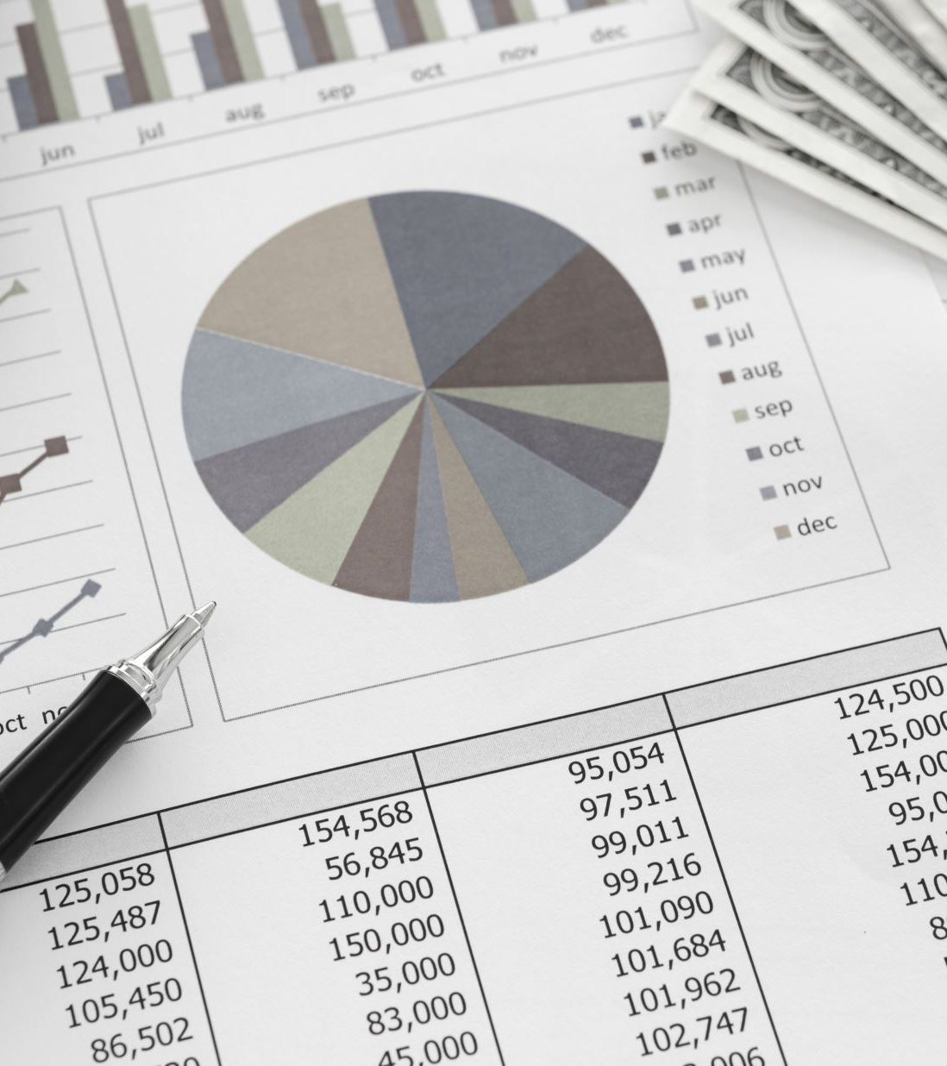
Project Overview:
Our team decided to develop a stock prediction model. We found a rudimentary model that we sought to improve. The original model used historical daily price data for publicly traded companies.

Slide 3

Project Questions
Comparing the Prediction Model from: https://data-flair.training/blogs/stock-price-prediction-machine-learning-project-in-python/ ...
Can we download the snippets of this code, and re-create a working model?
Can we find an API site instead of the CSV file, and create a working model that is always up-to-date?
If we add another industry (like Meme stocks vs Tech stocks), will the model continue to work?
Is there another prediction model that would work better?

Slide 4
Project Steps
Step 1: Pulling data from Yahoo Finance
Step 2: Cleaning the data
Step 3: Connecting PgAdmin and AWS to pull and store data
Step 4: Merge data to new (consolidated) dataframe via SQL
Step 5: Using that data make a model for prediction
Step 6: Create web html and hosting on web
Step 7: Use Tableau to show visualizations
Step 8: Put it all together

Slide 5
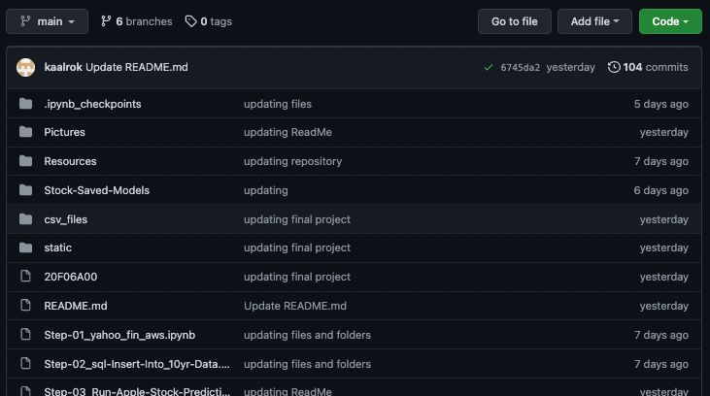
GitHub

Slide 6
Machine Learning Model - (ML)
Long Short Term Memory (LSTM)
LSTM: best available ML model for handling time series data
Found rudimentary model to use as a starting point
Used Yahoo Finance Library - more flexible and easier than Polygon API
Eliminated preprocessing of data prior to ML data processing
Determined use of date and close in model so used Python code to create a new dataframe
Used MinMaxScaler to scale the new dataframe on the training set to between 0 and 1.
Split data into train and test sets and set at 80% train / 20%
Built and trained model using Sequential function of LSTM

Slide 7

Machine Learning Model - (ML)
Long Short Term Memory (LSTM) - Continued
Continue
built model by determining feature and target
Compile
Compiled the model using mean squared error.
Train and test
Trained and tested the data
Use
Used Prediction function running the model with the test data.

Slide 8
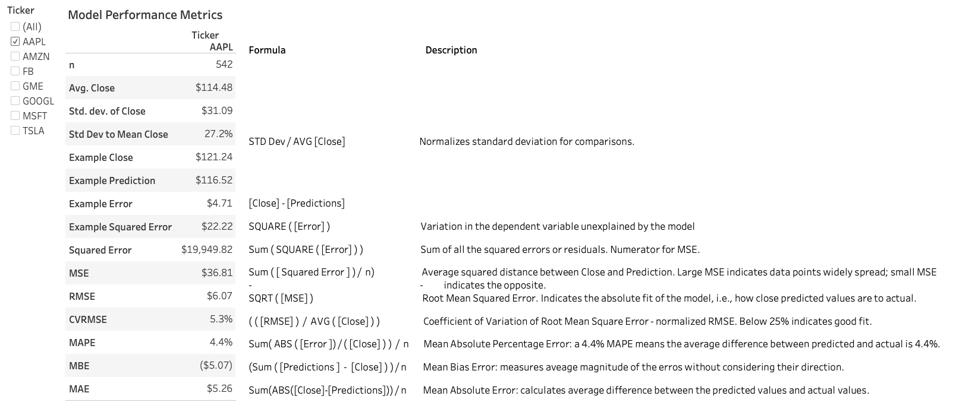
Machine Learning Model Performance Metrics:

Slide 9
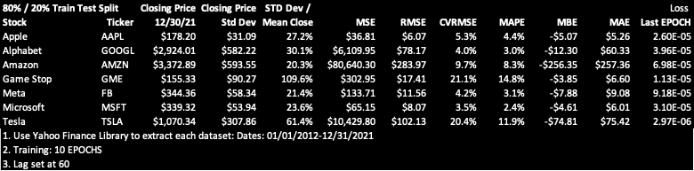
Machine Learning Model Results:

Slide 10
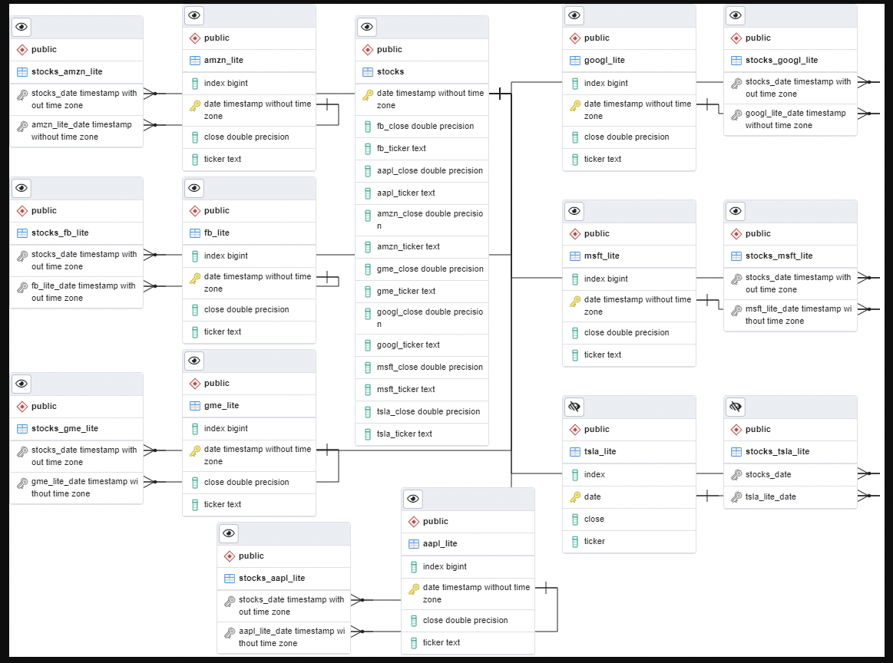
ML ERD:

Slide 11
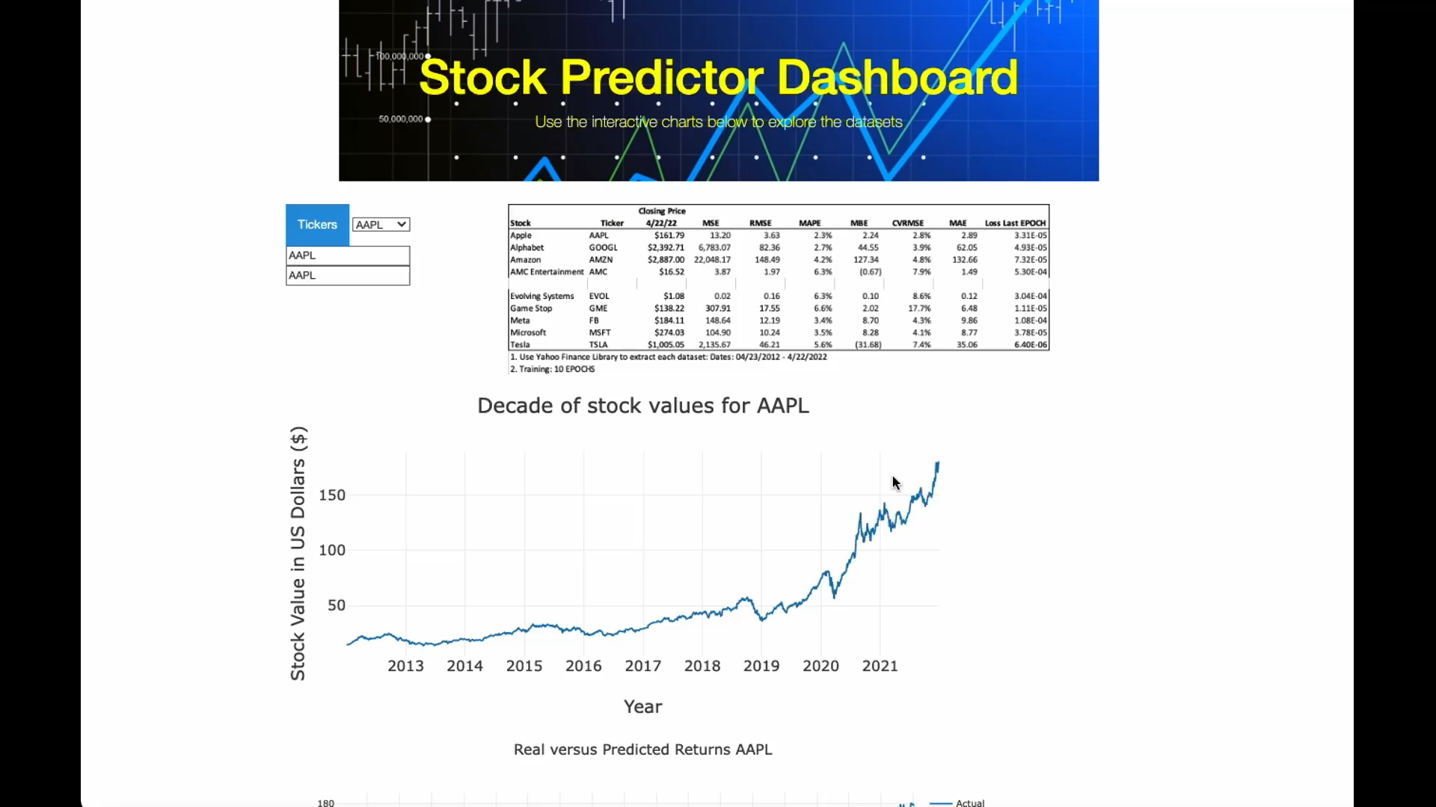
Dashboard

Slide 12
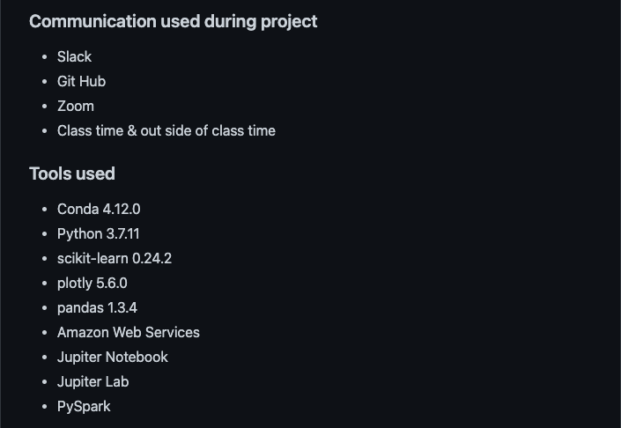
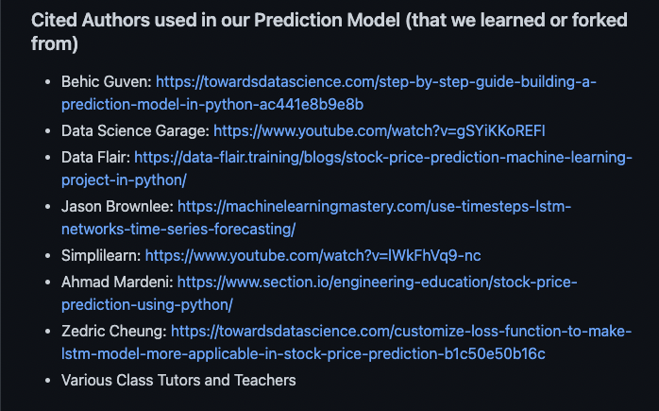
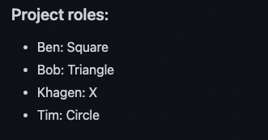
Tools, Reference & Role

Slide 13
Reference:
Cited Authors used in our Prediction Model (that we learned or forked from)
Behic Guven: https://towardsdatascience.com/step-by-step-guide-building-a-prediction-model-in-python-ac441e8b9e8b
Data Science Garage: https://www.youtube.com/watch?v=gSYiKKoREFI
Data Flair: https://data-flair.training/blogs/stock-price-prediction-machine-learning-project-in-python/
Jason Brownlee: https://machinelearningmastery.com/use-timesteps-lstm-networks-time-series-forecasting/
Simplilearn: https://www.youtube.com/watch?v=lWkFhVq9-nc
Ahmad Mardeni: https://www.section.io/engineering-education/stock-price-prediction-using-python/
Zedric Cheung: https://towardsdatascience.com/customize-loss-function-to-make-lstm-model-more-applicable-in-stock-price-prediction-b1c50e50b16c
Various Class Tutors and Teachers
Communication:
Slack
Git Hub
Zoom
Class time & outside of class time
Project Roles:
Ben: Square
Bob: Triangle
Khagen: X
Tim: Circle
Tools:
Conda 4.12.0
Python 3.7.11
scikit-learn 0.24.2
plotly 5.6.0
pandas 1.3.4
Amazon Web Services
Jupiter Notebook
Jupiter Lab
PySpark

Slide 14
Questions?

